Slide 1
Understanding Intrusion Detection Systems

Slide 2
Introduction
Internet is changing computing.
The possibilities and opportunities are limitless.
Secure information transmission is very important in the present scenario for healthy reputation and financial status.
Risks and chances of malicious involvement are increasing.
Intrusion attempt: The potential possibility of a deliberate unauthorized attempt to
Access Information
Manipulate Information
Render a system unreliable or unusable.

Slide 3
Introduction
An Intrusion Detection system (IDS)
Detects attacks as soon as possible and takes appropriate action.
Does not usually take preventive measures when an attack is detected.
It is a reactive rather than a pro-active agent.
It plays a role of informant rather than a police officer.

Slide 4
Introduction
The most popular way to detect intrusions has been using the audit data generated by the operating system.
An audit trail is a record of activities on a system that are logged to a file in chronologically sorted order.
Audit trails are particularly useful in establishing the guilt attackers.
They are often the only way to detect unauthorized but subversive user activity.

Slide 5
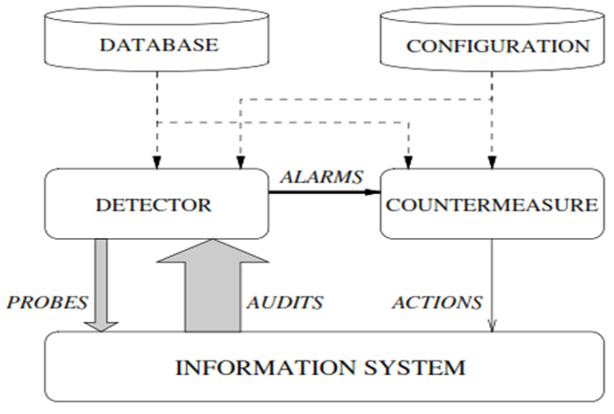
Very simple intrusion-detection system
Source: H. Debar, An Introduction to Intrusion-Detection System, IBM Research, Zurich Research Lab

Slide 6
Introduction
Secure information transmission is very important in the present scenario for healthy reputation and financial status.
Many intrusion detection systems are based on either signature information or anomaly that generate false detections.
A hybrid IDS proposed which uses the signature and anomaly information together can offer better detection.

Slide 7
Objectives
Understand the concept of IDS/IPS and the two major categorizations:
based on either signature information or
anomaly that generate false detections.
Discussion on proposed hybrid IDS
Be able to write a snort rule when given the signature and other configuration info

Slide 8
Definitions
Risk: Accidental exposure of information, or violation of operations integrity due to the malfunction of hardware or incomplete or incorrect software design.
Vulnerability: A known or suspected flaw in the h/w or s/w or operation of a system that exposes the system to penetration or its information to accidental disclosure.
Attack: A specific formulation or execution of a plan to carry out a threat.
Penetration: A successful attack.

Slide 9
Definitions
Intrusion
A set of actions aimed to compromise the security goals, namely
Integrity, confidentiality, or availability, of a computing and networking resource
Intrusion detection
The process of identifying and responding to intrusion activities
Intrusion prevention
Extension of ID with exercises of access control to protect computers from exploitation

Slide 10
Elements of Intrusion Detection
Primary assumptions:
System activities are observable
Normal and intrusive activities have distinct evidence
Components of intrusion detection systems:
From an algorithmic perspective:
Features - capture intrusion evidences
Models - piece evidences together
From a system architecture perspective:
Various components: audit data processor, knowledge base, decision engine, alarm generation and responses

Slide 11
Components of Intrusion Detection System
Audit Records
system activities are observable
Audit Data Preprocessor
Activity Data
Detection
Models
normal and intrusive activities have distinct evidence
Detection Engine
Alarms
Action/Report
Decision
Table
Decision Engine

Slide 12
Intrusion Detection Approaches
Modeling
Features: evidences extracted from audit data
Analysis approach: piecing the evidences together
Misuse detection ( signature-based)
Anomaly detection ( statistical-based)
Deployment: Network-based or Host-based
Network based: monitor network traffic
Host based: monitor computer processes
Notes:
Need “both” on all these.

Slide 13
Misuse Detection
pattern matching
Intrusion Patterns:
Sequences of system calls, patterns of network traffic, etc.
intrusion
activities
Example: if (traffic contains “x90+deZ^\r\n]{30}”) then “attack detected”
Advantage: Mostly accurate. But problems?
Can’t detect new attacks

Slide 14
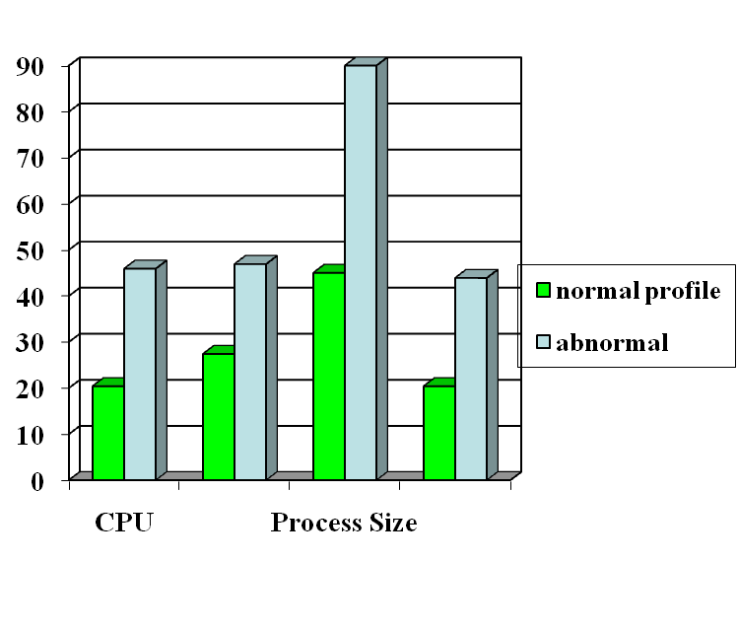
Anomaly Detection
probable intrusion
activity measures
Define a profile describing
“normal” behavior, then
detects deviations. Thus can detect potential new attacks.
Any problem ?
Relatively high false positive rates
Anomalies can just be new normal activities.
Anomalies caused by other element faults
E.g., router failure or misconfiguration, P2P misconfig
Which method will detect DDoS SYN flooding ?
Notes:
The two axis not shown are IO and page fault.

Slide 15
Host-Based IDSs
Use OS auditing and monitoring/analysis mechanisms to find malware
Can execute full static and dynamic analysis of a program
Monitor shell commands and system calls executed by user applications and system programs
Has the most comprehensive program info for detection, thus accurate
Problems:
If attacker takes over machine, can tamper with IDS binaries and modify audit logs
User dependent: install/update IDS on all user machines!
Only local view of the attack

Slide 16


Network Based IDSs
Internet
Gateway routers
Our network
Host based
detection
At the early stage of the worm, only limited worm samples.
Host based sensors can only cover limited IP space, which has scalability issues.
Might not be able to detect the worm in its early stage.

Slide 17
Network IDSs
Deploying sensors at strategic locations
For example, Packet sniffing via tcpdump at routers
Inspecting network traffic
Watch for violations of protocols and unusual connection patterns
Look into the packet payload for malicious code
Limitations
Cannot execute the payload or do any code analysis !
Even DPI gives limited application-level semantic information
Record and process huge amount of traffic
May be easily defeated by encryption, but can be mitigated with encryption only at the gateway/proxy
Notes:
Problems: mainly accuracy

Slide 18
Host-based vs. Network-based IDS
Give an attack that can only be detected by host-based IDS but not network-based IDS
Can you give an example only be detected by network-based IDS but not host-based IDS ?
Notes:
For the first: a unknown malware
For the second: botnet scanning or worm propagation

Slide 19
Problems with Current IDSs
Inaccuracy for exploit based signatures
Cannot recognize unknown anomalies/intrusions
Cannot provide quality info for forensics or situational-aware analysis
Hard to differentiate malicious events with unintentional anomalies
Anomalies can be caused by network element faults, e.g., router misconfiguration, link failures, etc., or application (such as P2P) misconfiguration
Cannot tell the situational-aware info: attack scope/target/strategy, attacker (botnet) size, etc.

Slide 20
Limitations of Exploit Based Signature
Signature: 10.*01
1010101
Internet
Traffic Filtering
10111101
X
Our network
X
11111100
00010111
Polymorphism!
Polymorphic worm might not have exact exploit based signature
Notes:
20

Slide 21


Vulnerability Signature
Vulnerability signature traffic filtering
Internet
X
X
Our network
X
X
Vulnerability
Work for polymorphic worms
Work for all the worms which target the
same vulnerability
Notes:
21

Slide 22
Example of Vulnerability Signatures
At least 75% vulnerabilities are due to buffer overflow
Sample vulnerability signature
Field length corresponding to vulnerable buffer > certain threshold
Intrinsic to buffer overflow vulnerability and hard to evade
Overflow!
Protocol message
Vulnerable buffer

Slide 23
Related Tools for Network IDS (I)
While not an element of Snort, wireshark (used to called Ethereal) is the best open source GUI-based packet viewer
www.wireshark.org offers:
Support for various OS: windows, Mac OS.
Included in standard packages of many different versions of Linux and UNIX
For both wired and wireless networks

Slide 24
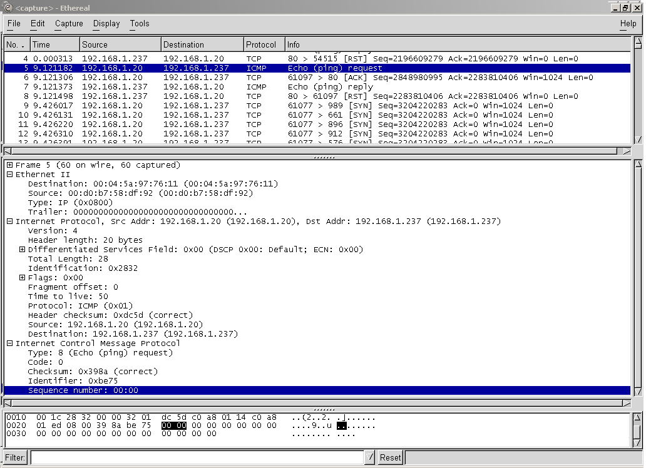

Slide 25
Active Intrusion Detection Systems
Passive systems can only send an alarm to an administrator when there is an attempt in progress.
An active system can take control of the situation by disconnecting the assailant
Methods:
Session Disruption:
IDS may send a TCP reset packet if the attacker has opened a TCP connection to the victim
IDS may send various UDP packets to disrupt a UDP connection
Will not permanently remedy the situation only disconnect the current connection
Rule Modification
IDS is linked to a firewall via an administrative link
IDS communicates with the firewall telling it to drop all packets from the attackers IP Address

Slide 26
Anomaly based detection
Anomaly based detection algorithms create a model of normal use.
Look for deviation in the activities that do not conform to normal behavior.
Data mining and artificial intelligence can be used to find outlier patterns.
Advantage: can detect unknown or new attacks.
Most of the available IDSs use one of the two detection algorithms. To improve the detection process misuse detection can be combined with anomaly

Slide 27
HYBRID INTRUSION DETECTION
The hybrid intrusion detection (HID) algorithm combines anomaly detection using seeded k-means and misuse based detection using tuned Snort rules
The network traffic is analyzed where the packets are captured using libpcap tool of the operating system.
Preprocessing and decoding of the captured packets is done using unmodified Snort-IDS.

Slide 28
HYBRID INTRUSION DETECTION
Next misuse-based detection is carried out for signature and contains matching through modified and tuned snort rules.
Thereafter anomaly based detection is performed by trained seeded k-means clustering algorithm.

Slide 29
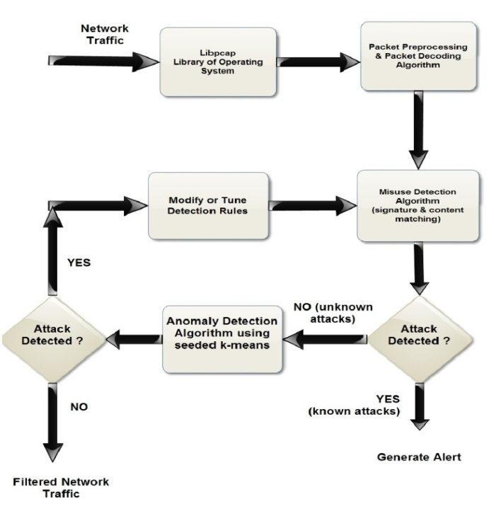
Flowchart of proposed model

